Slide 1
Jurica Žugaj, Filip Kramarić 3.b

Slide 2
What is Erasmus+?
Erasmus+ is the biggest program of the European union for educating, traning, the youth and sport.
Youth Exchange which allows groups of young people from different countries to meet, live together and collaborate on joint projects over short periods.
Youth exchanges take place outside the school environment. In the youth exchange you can participate in activities such as workshops, exercises, debates, role plays, outdoor activities and many others.

Slide 3
Duration and conditions:
Between 5 and 21 days not including the travel time.
Youth exchanges are available to people between 13 and 30 years old.

Slide 4
The goal of Erasmus+:
Youth changes enable them to develop competencies, become aware of socially relevant topics, discover new cultures, etc.
Each topic has a specific goal of its project, an example. Erasmus Zagreb 2021 topic was about mental health „Not All Wounds Are Visible”

Slide 5
Erasmus+ Youth Exchange Zagreb 2021;
Not All Wounds Are Visible was the topic of this year's Erasmus + A total of 40 students from 3 countries participated; Croatia (15), Romania (13) and Bulgaria (12)
The theme was about Mental health.
The project lasted 10 days.
The location was the Student Home Novi Zagreb.

Slide 6
Not All Wound Are Visible:
Workshops;
Types of Mental Health Issues
City Run
Reflection Groups
Draw What I Say
Active Listening
Sljeme
Body Art
Can you change my opinion
Etc…

Slide 7
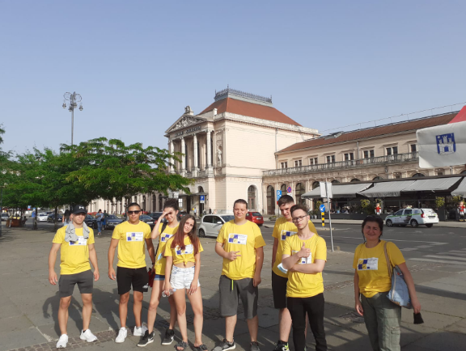
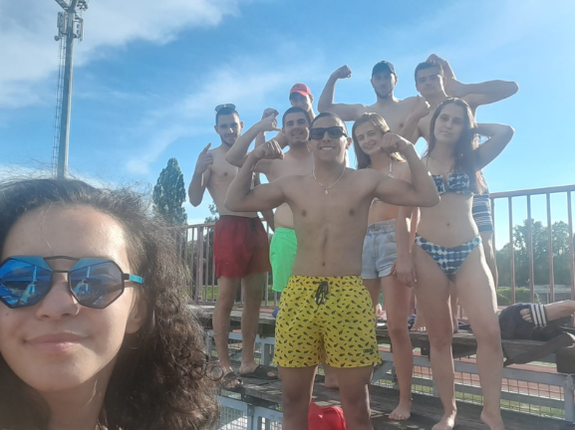
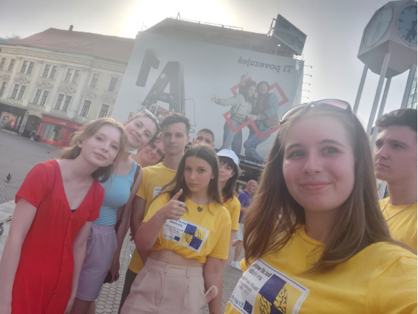
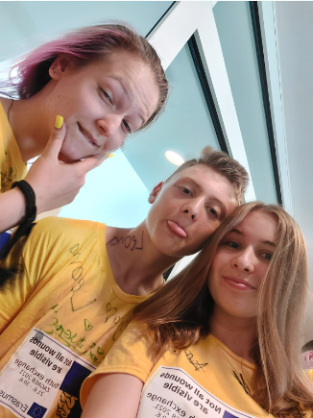
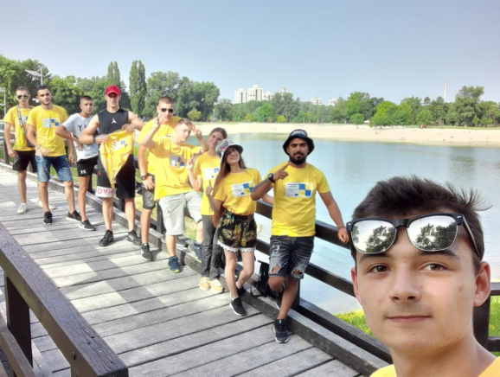
CITY RUN

Slide 8
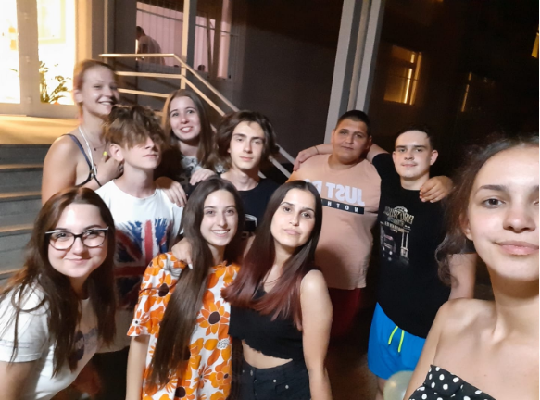
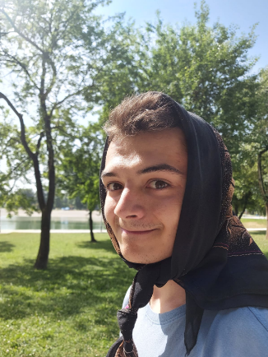
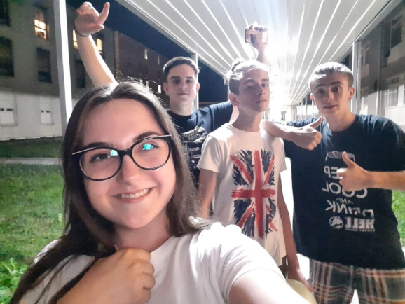
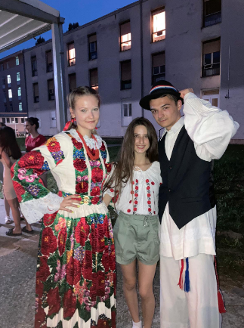
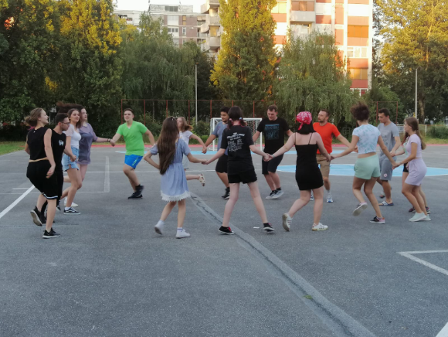
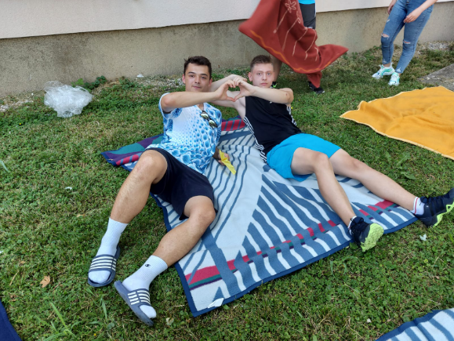
PICTURES

Slide 9
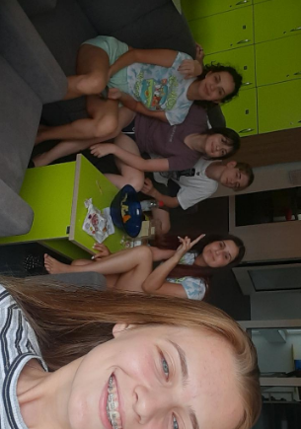
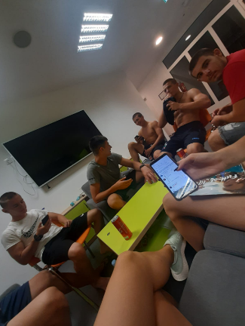
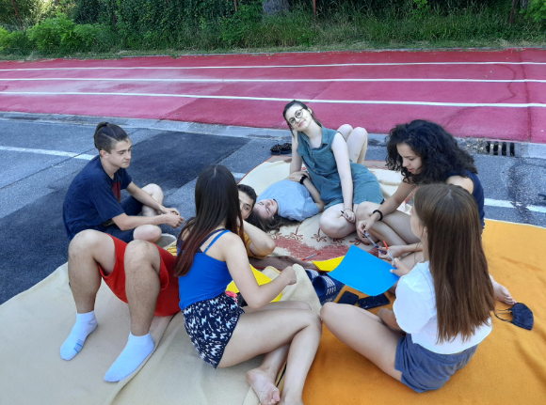
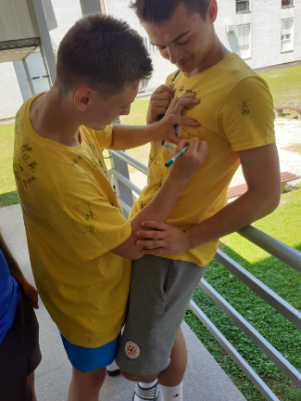
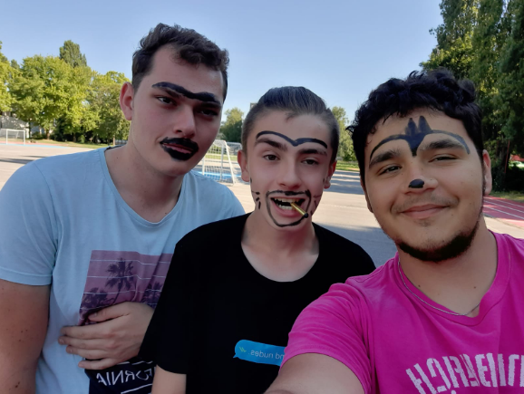
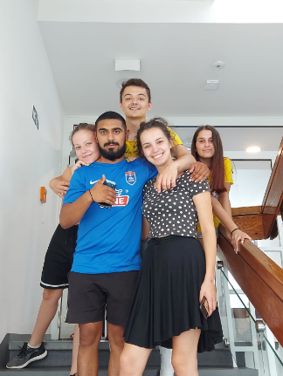
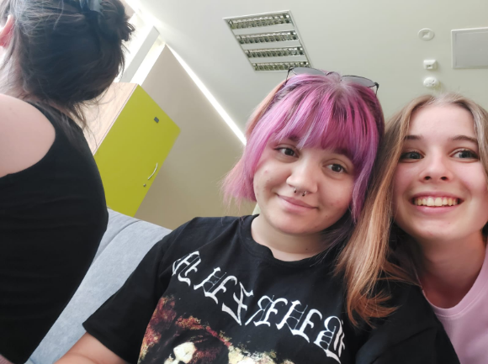

Slide 10
Conclusion

